Slide 1





Fire Detection & Safety System
An Atmega32-based Fire Detection & Safety System engineered for real-time sensor monitoring, hazard evaluation and automated emergency response.

Slide 2
Project Overview & Motivation
System Overview
An automated real-time safety system built on ATmega32 MCU to continuously monitor temperature (LM35) and gas/smoke levels (MQ-2).
Core Functionality
Processes environmental data via a Finite State Machine (FSM) to handle tiered hazard levels and activate local alarms.
The Problem
Traditional fire alarms rely on simple binary detection, causing frequent false alarms or critical response delays in hazardous environments.
Motivation
Delivers early, multi-stage detection with automatic mitigation, immediate visual/audio alerts, and real-time UART status logging.

Slide 3



System Objectives & Safety Requirements
Real-Time Sensing
Safety State Machine
Operator Interface
Continuous ADC sampling of analog ambient temperature (LM35) and environmental smoke concentration (MQ-2 simulation).
Multi-tiered threat evaluation categorizing environment states into Normal, Warning, Alarm, and Critical Emergency.
Visual status telemetry via 16x2 LCD, audible buzzer alarms, push-button acknowledgment, and serial diagnostics via UART.

Slide 4



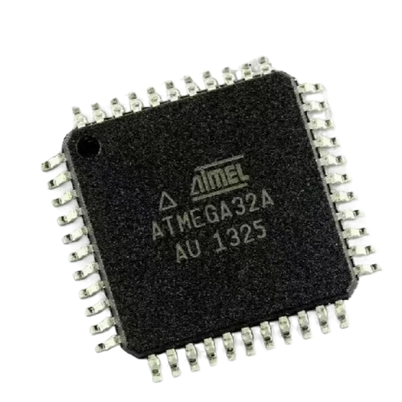
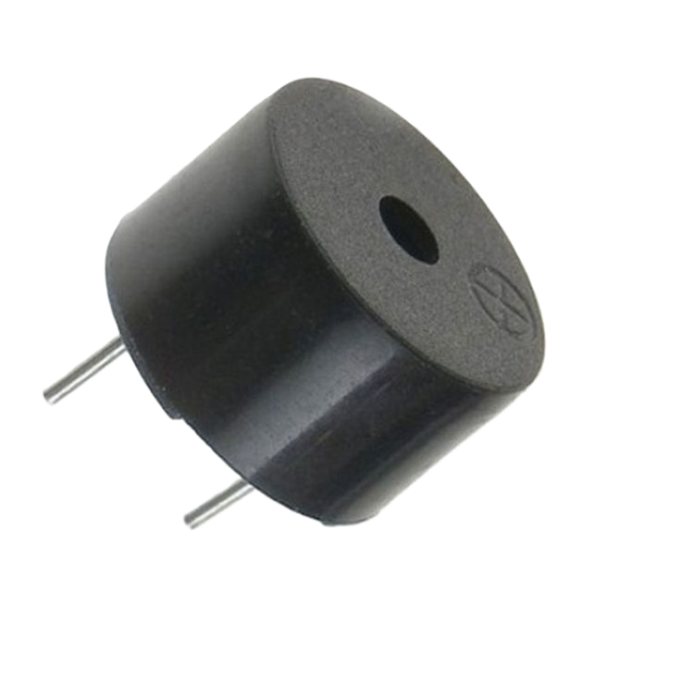
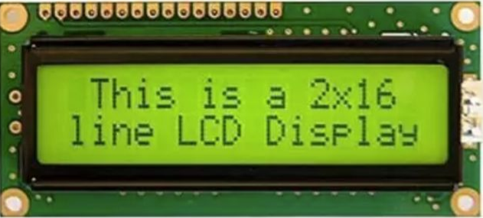



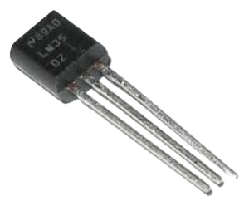
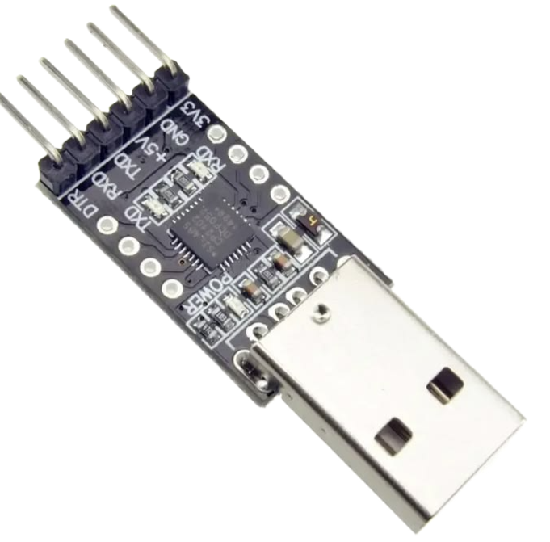
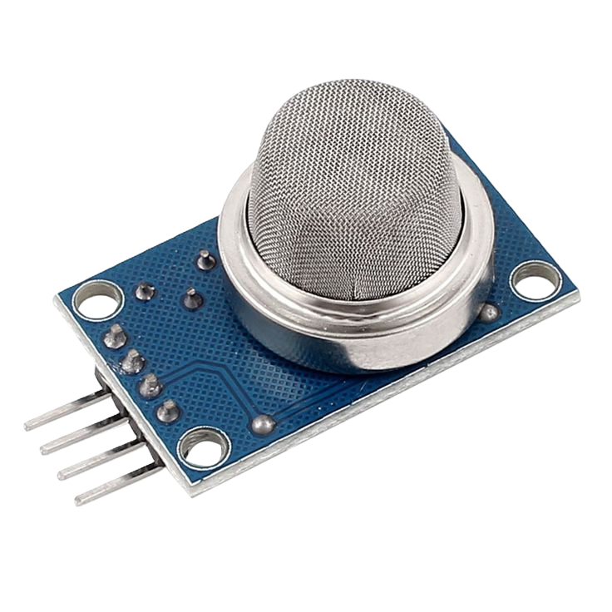
Hardware Stack & Components

Slide 5










Layered Software Architecture
APP Layer
HAL Layer
MCAL Layer
LIB Layer
High-level control loops in main.c, Fire_Controller.c, and Safety_Manager.c orchestrating state machines.
Hardware Abstraction Drivers for 16x2 LCD, LM35 Temp sensor, MQ-2 Smoke sensor, Buzzer, LEDs, and Buttons.
Low-level microcontroller drivers directly accessing ATmega32 hardware for ADC, DIO, UART, TIMER0, and EXTI.
Reusable macros and standard types (STD_TYPES.h, BIT_MATH.h) ensuring code portability and clean bit manipulations.

Slide 6
Tier Safety Warning Matrix
Warning Level | Environmental Condition | Primary Output Actions | System State
Level 0 | Normal Temp (< 45°C), No Smoke/Flame | Green LED ON | Buzzer OFF | LCD: Normal | 🟢 NORMAL
Level 1 | Elevated Temp (45-60°C) or Slight Smoke | Yellow LED ON | LCD Warning | UART Alert Log | 🟡 WARNING
Level 2 | High Temp (60-70°C) OR Heavy Smoke/Flame | Red LED ON | Continuous Buzzer | LCD Alarm | 🔴 FIRE ALARM
Level 3 | High Temp OR Heavy Smoke / Flame Detected | Flashing Red LED | Intermittent Loud Buzzer | Lockout | ⚫ EMERGENCY

Slide 7
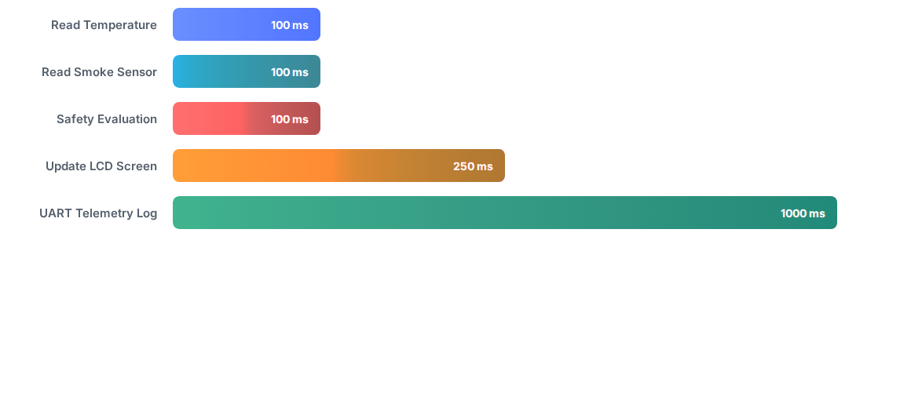
Monitoring Execution Schedule
Deterministic Periodic Task Execution: High-frequency tasks (Sensor Sampling & Safety Evaluation) execute every 100 ms via Timer interrupts, ensuring rapid hazard reaction time without LCD display lag.

Slide 8
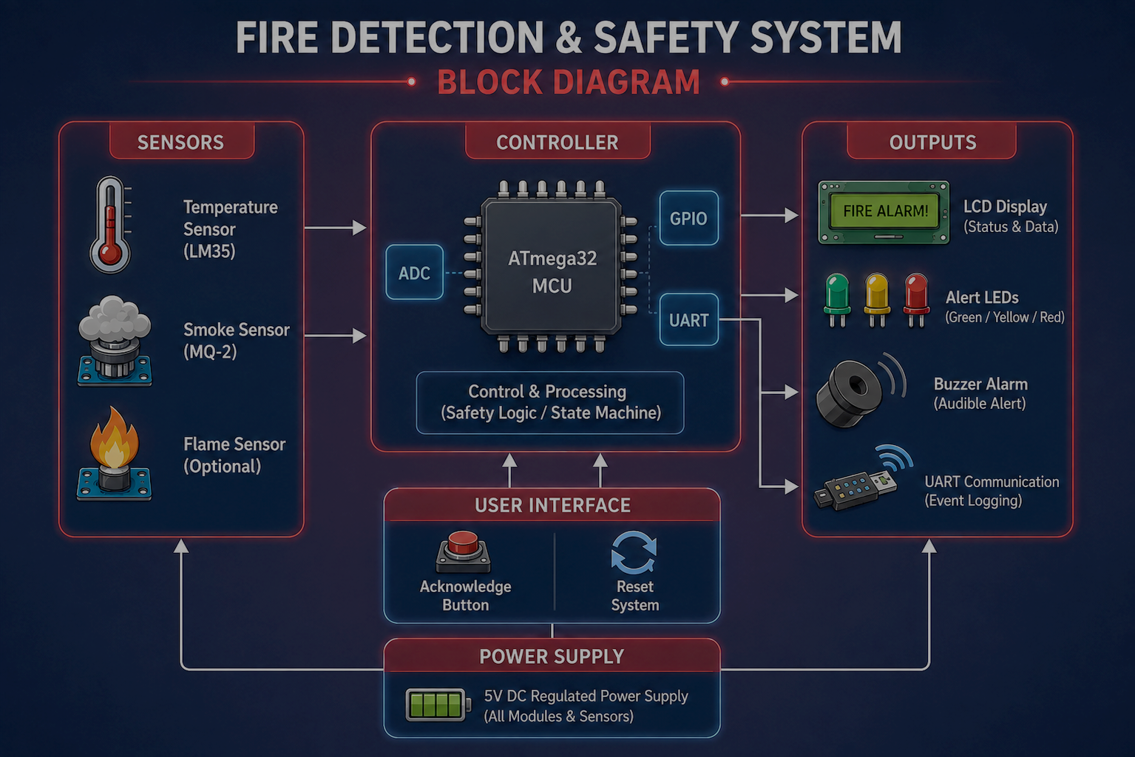

Slide 9
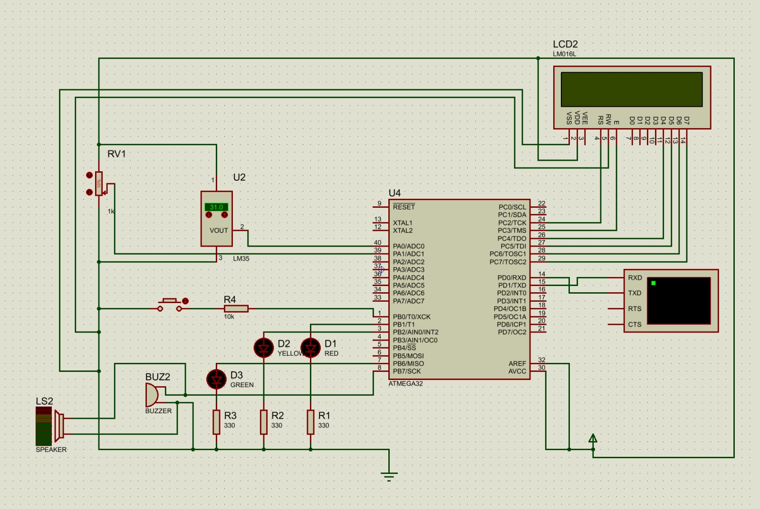
Simulation Layout

Slide 10


Future System Extensions
Remote Extensions
Active Protection & Hazards
GSM & Wi-Fi Alerts: Automated SMS & Cloud telemetry.
Management Notifications: Instant alerts for critical fire severity levels.
Gas & CO Detection: Combustible gas & Carbon Monoxide sensing.
Auto Sprinklers: Water relay activation for active fire suppression.
Multi Zone System
System Reliability
Zone Tracking: Multi-sensor spatial location detection.
Mobile App: Real-time multi-zone dashboard & controls.
SD Card Logging: Offline event & sensor data storage.
Battery Backup: Continuous operation during power outages.

Slide 11






Questions & Discussion
Thanks for your attention
Development Team: Resistors on Fire
Supervision: Eng. Hesham Ahmed | Organization: Gestell / NTI Embedded Systems Diploma

